Slide 1
MACHINE LEARNING and data analysis

Slide 2
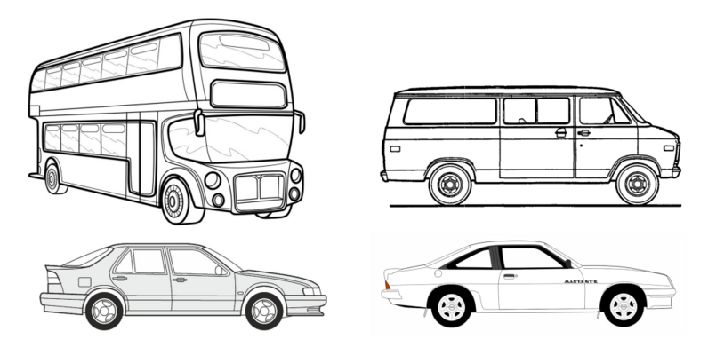
Statlog Vehicle Silhouettes Dataset

Slide 3
description
The HIPS (Hierarchical Image Processing System) extension BINATTS was employed to extract features from the silhouettes. BINATTS utilizes a combination of scale-independent features, including classical moments-based measures such as scaled variance, skewness, and kurtosis about the major/minor axes, as well as heuristic measures such as hollows, circularity, rectangularity, and compactness.
For the experiment, four model vehicles of the "Corgi" brand were utilized: a double-decker bus, a Chevrolet van, a Saab 9000, and an Opel Manta 400. This specific selection of vehicles was made with the intention of easily distinguishing the bus, van, and one of the cars, while making it more challenging to differentiate between the cars.
Notes:
Description:
The HIPS (Hierarchical Image Processing System) extension BINATTS was employed to extract features from the silhouettes. BINATTS utilizes a combination of scale-independent features, including classical moments-based measures such as scaled variance, skewness, and kurtosis about the major/minor axes, as well as heuristic measures such as hollows, circularity, rectangularity, and compactness.
For the experiment, four model vehicles of the "Corgi" brand were utilized: a double-decker bus, a Chevrolet van, a Saab 9000, and an Opel Manta 400. This specific selection of vehicles was made with the intention of easily distinguishing the bus, van, and one of the cars, while making it more challenging to differentiate between the cars.
Tanım:
Siluetlerden özellikleri çıkarmak için HIPS (Hiyerarşik Görüntü İşleme Sistemi) uzantısı BINATTS kullanıldı. BINATTS, büyük/küçük eksenler hakkında ölçekli varyans, çarpıklık ve basıklık gibi klasik moment tabanlı ölçüler ve boşluklar, dairesellik, dikdörtgenlik ve kompaktlık gibi buluşsal ölçüler dahil olmak üzere ölçekten bağımsız özelliklerin bir kombinasyonunu kullanır.
Deney için "Corgie" marka dört model araç kullanıldı: çift katlı otobüs, Chevrolet minibüs, Saab 9000 ve Opel Manta 400. Bu özel araç seçimi, otobüsü, minibüsü ve arabalardan birini kolayca ayırt etmek ve arabaları ayırt etmeyi zorlaştırmak amacıyla yapılmıştır.

Slide 4
Description cont’d
The images were captured by a camera positioned above the model vehicles at a fixed angle of elevation (34.2 degrees relative to the horizontal). The vehicles were positioned on a diffuse backlit surface known as a lightbox. To minimize highlights, the vehicles were painted matte black. A CRS4000 Framestore connected to a Vax 750 was used to capture the images. All images had a spatial resolution of 128x128 pixels and were quantized to 64 grey levels. These images were then thresholder to generate binary vehicle silhouettes, which were negated to comply with BINATTS' processing requirements. Subsequently, a series of HIPS modules (shrink-expand-expand-shrink) were applied to the silhouettes to eliminate "salt and pepper" image noise.
To determine the vehicles' orientation, they were rotated, and their angles were measured using a radial graticule positioned beneath each vehicle. In this setup, 0 and 180 degrees represented the "head-on" and "rear" views respectively, while 90 and 270 degrees corresponded to profiles in opposite directions. For each vehicle, two sets of 60 images were captured, covering a full 360-degree rotation. The vehicles were rotated by a fixed angle between consecutive images. These datasets were named e2 and e3 respectively. Additionally, two more sets of images, namely e4 and e5, were obtained with the camera positioned at elevations of 37.5 degrees and 30.8 degrees respectively. Similar to the previous sets, each of these sets contained 60 images per vehicle, except for e4.van, which had only 46 images due to the challenges of capturing the entire van within the frame in certain orientations.
Notes:
Description Cont’d:
The images were captured by a camera positioned above the model vehicles at a fixed angle of elevation (34.2 degrees relative to the horizontal). The vehicles were positioned on a diffuse backlit surface known as a lightbox. To minimize highlights, the vehicles were painted matte black. A CRS4000 Framestore connected to a Vax 750 was used to capture the images. All images had a spatial resolution of 128x128 pixels and were quantized to 64 grey levels. These images were then thresholder to generate binary vehicle silhouettes, which were negated to comply with BINATTS' processing requirements. Subsequently, a series of HIPS modules (shrink-expand-expand-shrink) were applied to the silhouettes to eliminate "salt and pepper" image noise.
To determine the vehicles' orientation, they were rotated, and their angles were measured using a radial graticule positioned beneath each vehicle. In this setup, 0 and 180 degrees represented the "head-on" and "rear" views respectively, while 90 and 270 degrees corresponded to profiles in opposite directions. For each vehicle, two sets of 60 images were captured, covering a full 360-degree rotation. The vehicles were rotated by a fixed angle between consecutive images. These datasets were named e2 and e3 respectively. Additionally, two more sets of images, namely e4 and e5, were obtained with the camera positioned at elevations of 37.5 degrees and 30.8 degrees respectively. Similar to the previous sets, each of these sets contained 60 images per vehicle, except for e4.van, which had only 46 images due to the challenges of capturing the entire van within the frame in certain orientations.
Tanım Devam:
Görüntüler, model araçların üzerine sabit bir yükseklik açısında (yataya göre 34,2 derece) yerleştirilmiş bir kamera tarafından alınmıştır. Araçlar, ışık kutusu olarak bilinen dağınık arkadan aydınlatmalı bir yüzey üzerine yerleştirildi. Vurguları en aza indirmek için araçlar mat siyaha boyandı. Görüntüleri yakalamak için bir Vax 750'ye bağlı bir CRS4000 Framestore kullanıldı. Tüm görüntüler 128x128 piksellik bir uzamsal çözünürlüğe sahipti ve 64 gri düzeyinde işlem yapıldı. Bu görüntüler daha sonra, BINATTS'ın işleme gerekliliklerine uymak ve reddedilen ikili araç silüetleri oluşturmak için eşiklendi. Ardından, "tuz ve biber" görüntü gürültüsünü ortadan kaldırmak için silüetlere bir dizi HIPS modülü (shrink-expand-expand-shrink) uygulandı.
Araçların yönünü belirlemek için döndürüldü. Ve açıları, her bir aracın altına yerleştirilmiş radyal bir ızgara kullanılarak ölçüldü. Bu kurulumda, 0 ve 180 derece sırasıyla "önden" ve "arkadan" görünümleri temsil ederken, 90 ve 270 derece zıt yönlerdeki profillere karşılık geliyordu. Her araç için, tam 360 derecelik bir dönüşü kapsayan iki set 60 görüntü alındı. Ardışık görüntüler arasında araçlar sabit bir açı ile döndürüldü. Bu veri kümeleri sırasıyla e2 ve e3 olarak adlandırıldı. Ek olarak, kamera sırasıyla 37,5 derece ve 30,8 derece açılara konumlandırılarak e4 ve e5 olmak üzere iki set daha görüntü elde edildi. Önceki setlere benzer şekilde, bu setlerin her biri araç başına 60 resim içeriyordu, ancak tüm minibüsü belirli yönlerde çerçeve içinde yakalamanın zorlukları nedeniyle yalnızca 46 resim içeren e4.van vardı.

Slide 5
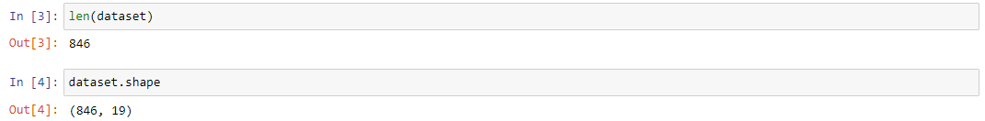
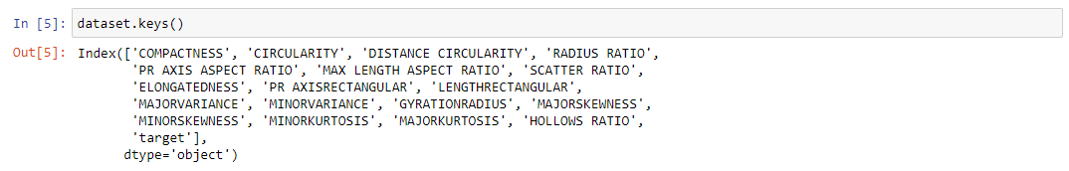
Data collection and pre-processing
-Uploading the selected dataset to Jupyter notebook.
-Learning about the size of the dataset.
-Finding the names of the columns that dataset has.

Slide 6
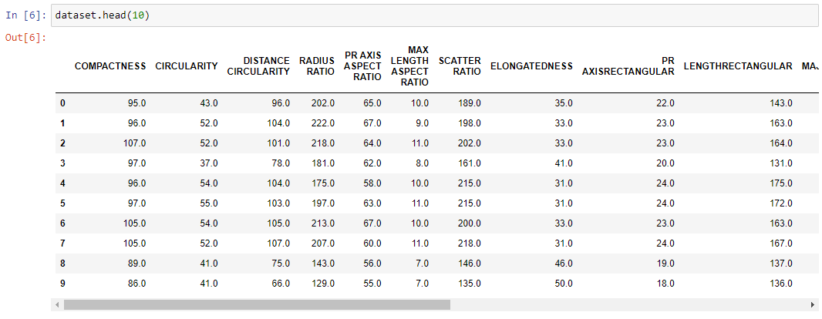
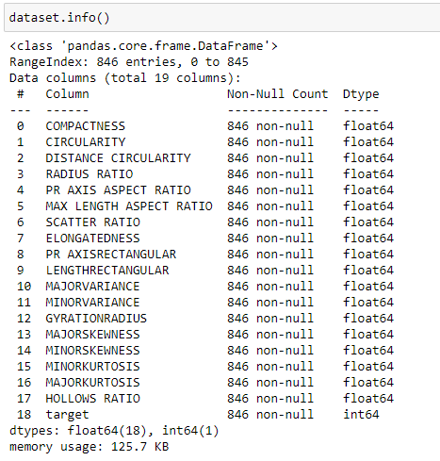
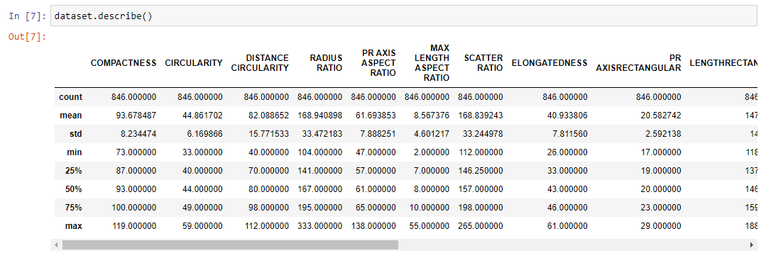
-Seeing general information about the dataset.

Slide 7
-Definitions of columns in the database.
COMPACTNESS: Compactness measure of the object.
CIRCULARITY: Circularity measure of the object.
DISTANCE CIRCULARITY: Distance circularity measure of the object.
RADIUS RATIO: Radius ratio of the object.
PR AXIS ASPECT RATIO: Aspect ratio of the object's PR axis.
MAX LENGTH ASPECT RATIO: Aspect ratio of the object's maximum length.
SCATTER RATIO: Scatter ratio of the object.
ELONGATEDNESS: Elongatedness measure of the object.
PR AXIS RECTANGULAR: Rectangular aspect ratio of the object's PR axis.
LENGTH RECTANGULAR: Rectangular aspect ratio of the object's length.
MAJOR VARIANCE: Major variance of the object.
MINOR VARIANCE: Minor variance of the object.
GYRATION RADIUS: Gyration radius of the object.
MAJOR SKEWNESS: Major skewness of the object.
MINOR SKEWNESS: Minor skewness of the object.
MINOR KURTOSIS: Minor kurtosis of the object.
MAJOR KURTOSIS: Major kurtosis of the object.
HOLLOWS RATIO: Hollows ratio of the object.
target: Target variable.
Notes:
COMPACTNESS: Compactness measure of the object./ Nesnenin kompaklık ölçüsü.
CIRCULARITY: Circularity measure of the object./ Nesnenin dairesellik ölçüsü.
DISTANCE CIRCULARITY: Distance circularity measure of the object./ Nesnenin dairesel uzaklık ölçüsü.
RADIUS RATIO: Radius ratio of the object./ Nesnenin yarıçap oranı.
PR AXIS ASPECT RATIO: Aspect ratio of the object's PR axis./ PR ekseninin en-boy oranı.
MAX LENGTH ASPECT RATIO: Aspect ratio of the object's maximum length./ Maksimum uzunluk en-boy oranı.
SCATTER RATIO: Scatter ratio of the object./ Dağılım oranı.
ELONGATEDNESS: Elongatedness measure of the object./ Nesnenin uzatılmışlık ölçüsü.
PR AXIS RECTANGULAR: Rectangular aspect ratio of the object's PR axis./ PR ekseninin dikdörtgenlik oranı.
LENGTH RECTANGULAR: Rectangular aspect ratio of the object's length./ Uzunluk dikdörtgenlik oranı.
MAJOR VARIANCE: Major variance of the object./ Büyük varyans.
MINOR VARIANCE: Minor variance of the object./ Küçük varyans.
GYRATION RADIUS: Gyration radius of the object./ Devir yarıçapı.
MAJOR SKEWNESS: Major skewness of the object./ Büyük çarpıklık.
MINOR SKEWNESS: Minor skewness of the object./ Küçük çarpıklık.
MINOR KURTOSIS: Minor kurtosis of the object./ Küçük kurtosis.
MAJOR KURTOSIS: Major kurtosis of the object./ Büyük kurtosis.
HOLLOWS RATIO: Hollows ratio of the object./ Boşluk oranı.
target: Target variable./ Hedef değişkeni.

Slide 8
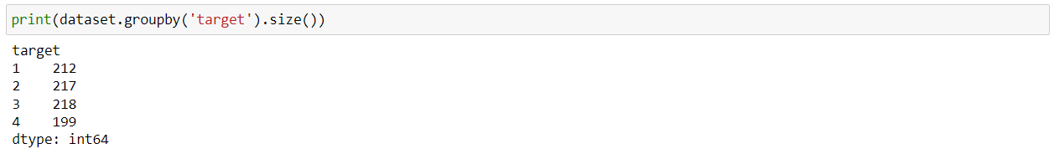
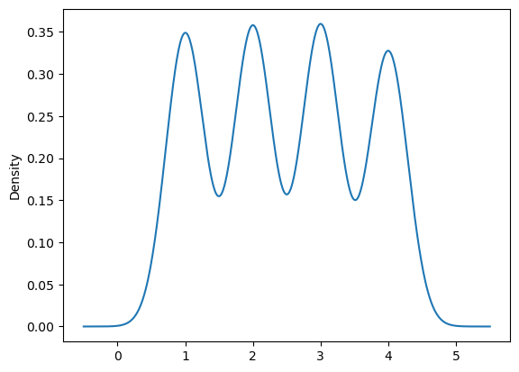
Select Target Value
-Finding the unique values of the target variable in the dataset.
-Finding the number of each value of the target variable by grouping.
-Plot the density graph of the target variable.

Slide 9
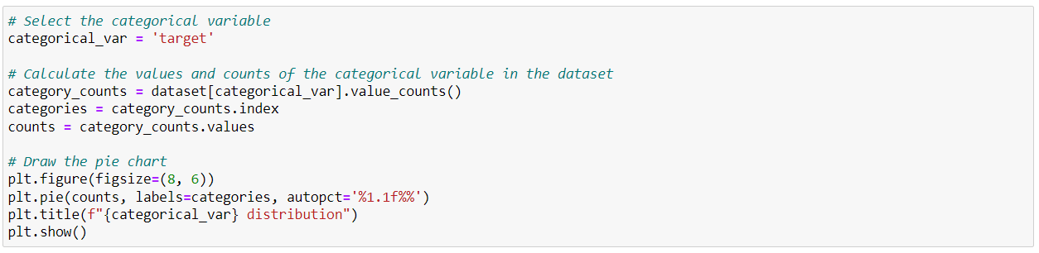
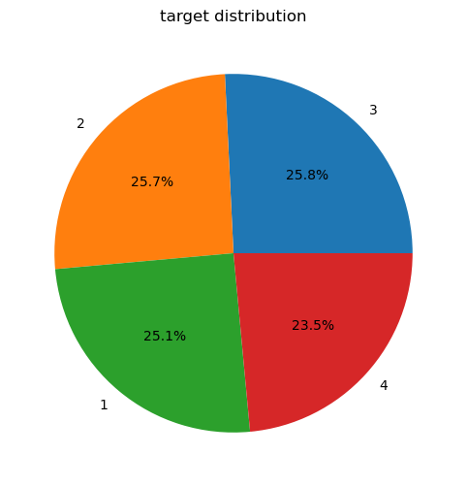
Select Target Value Cont’d
-A pie chart or donut chart is used to show the percentages of categorical data.

Slide 10
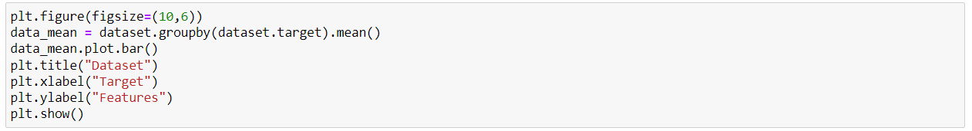
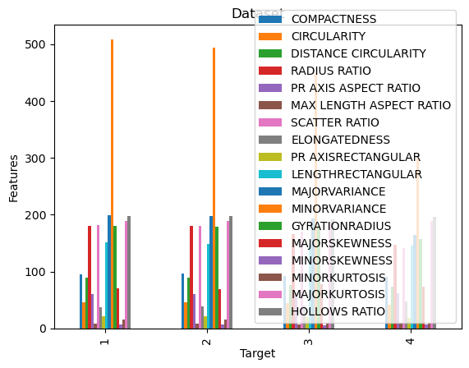
-Show the averages of each columns as histograms.

Slide 11
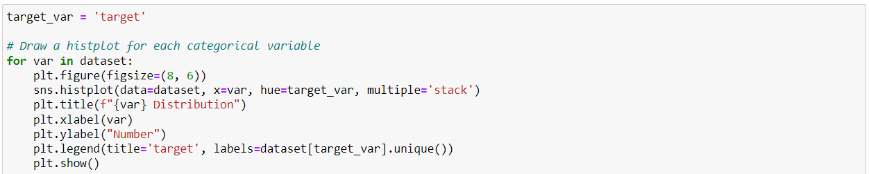
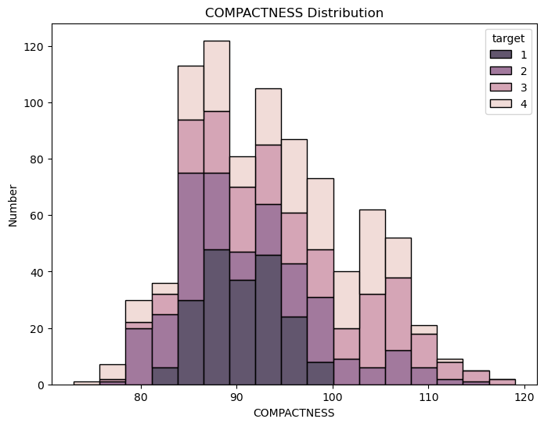
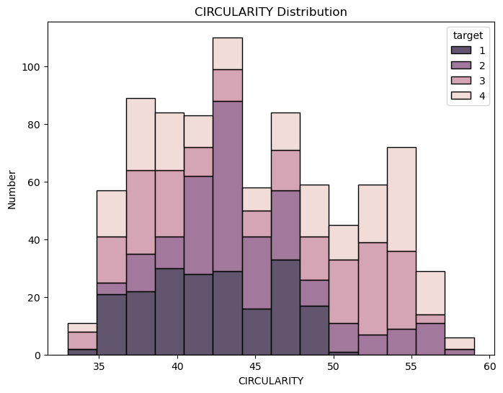
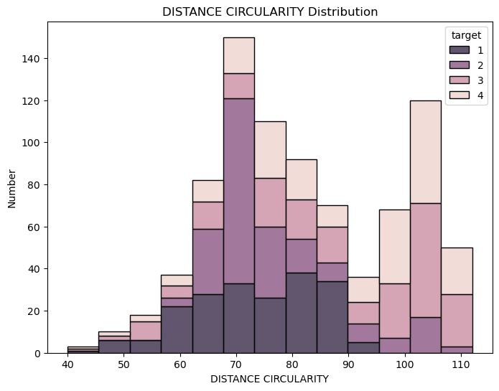
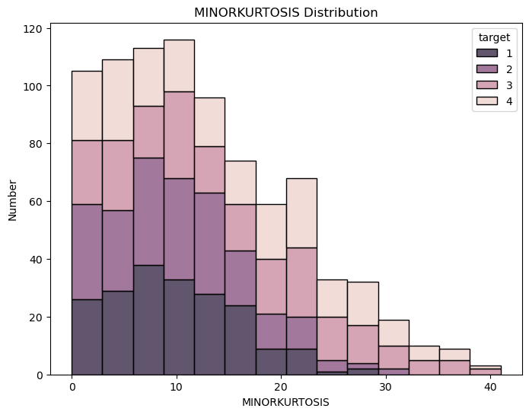
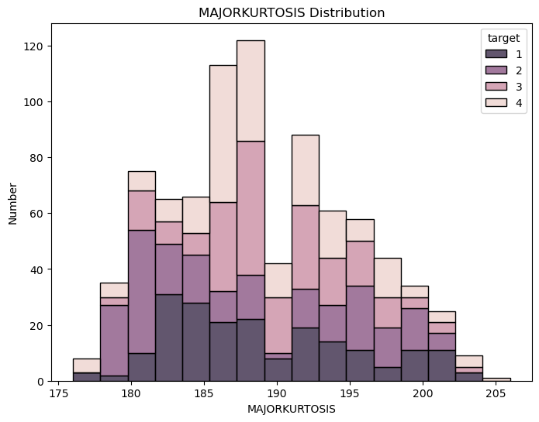
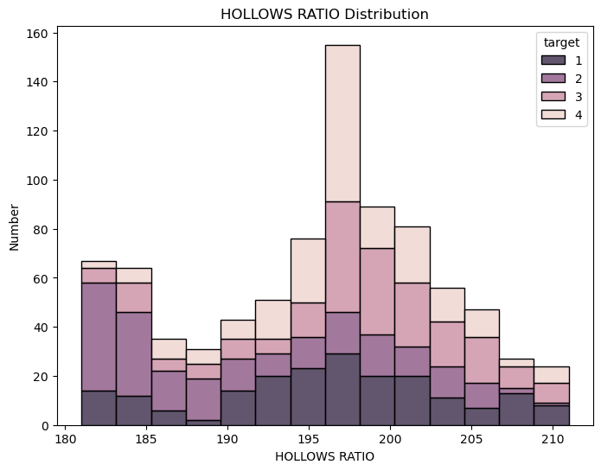
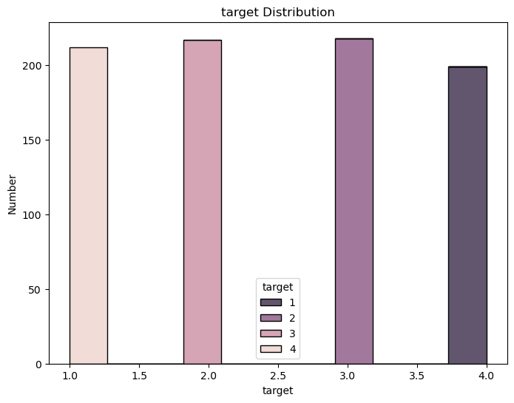
-Used to show the distribution or density of the data set.

Slide 12
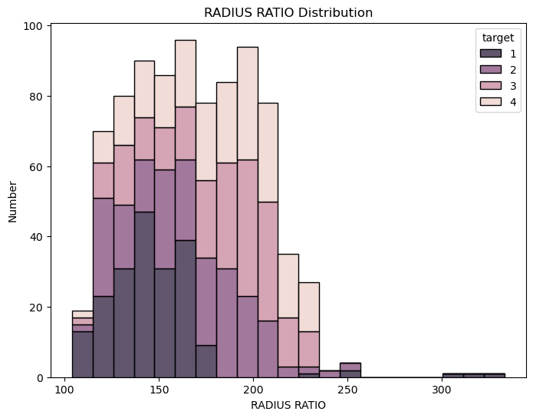
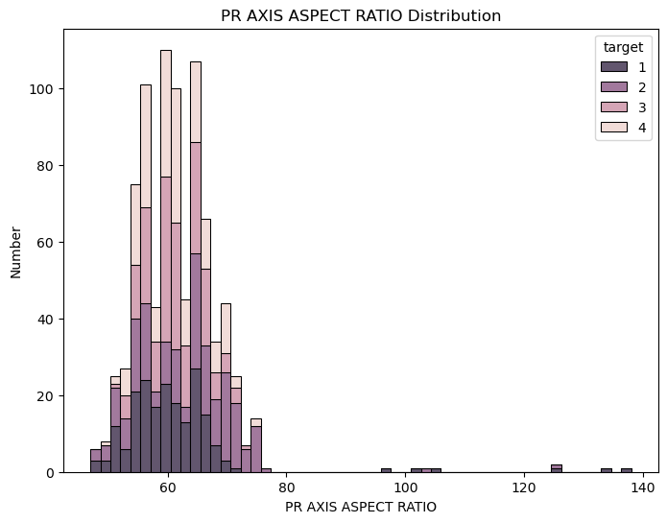
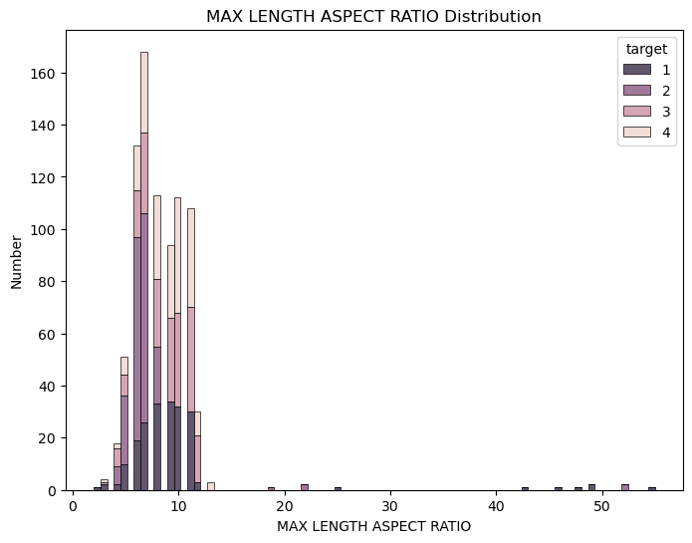
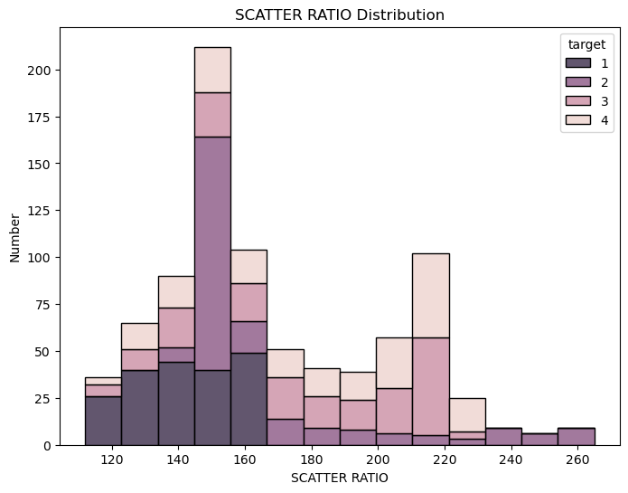
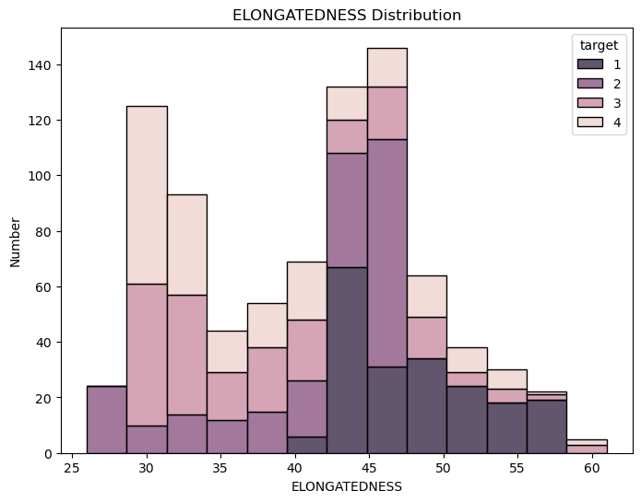
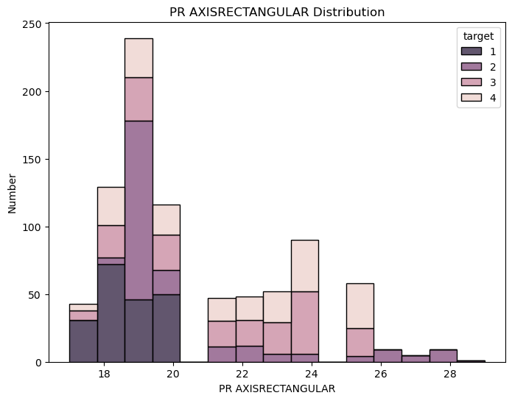
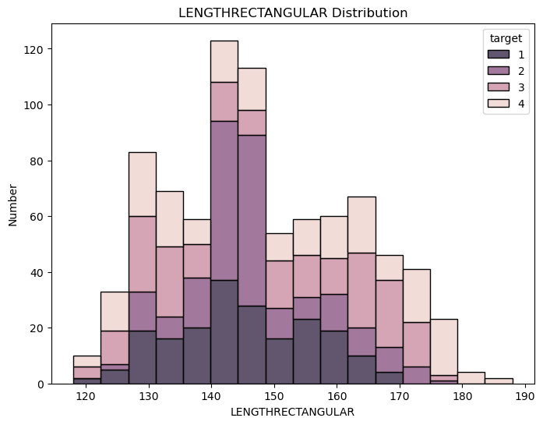
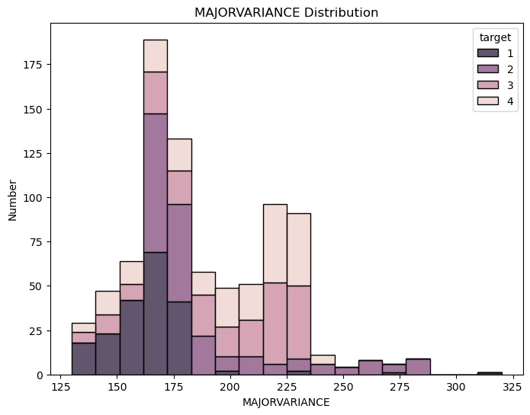
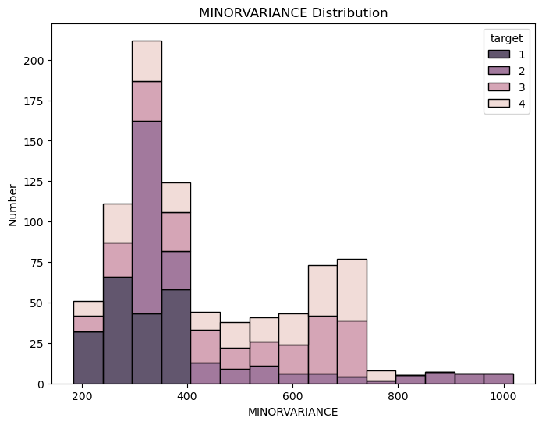
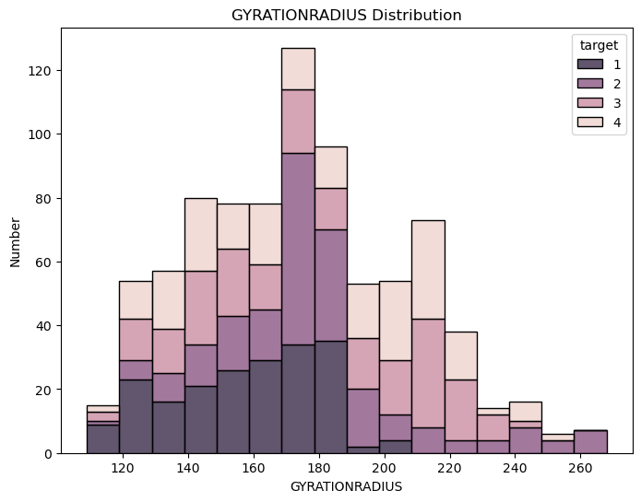
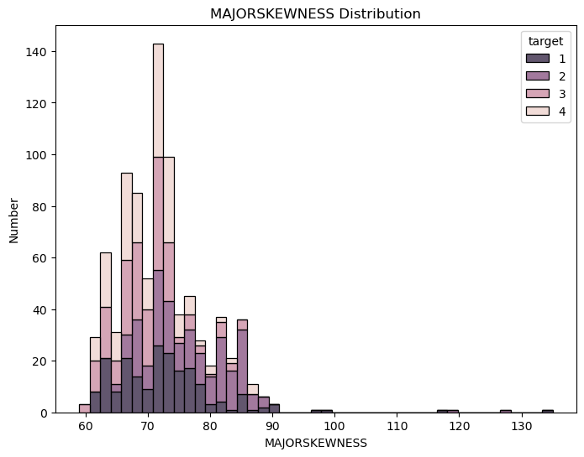
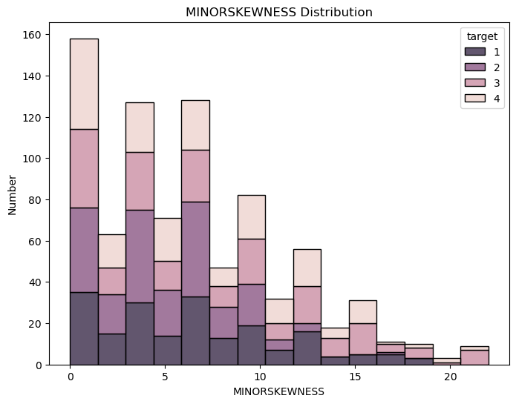

Slide 13
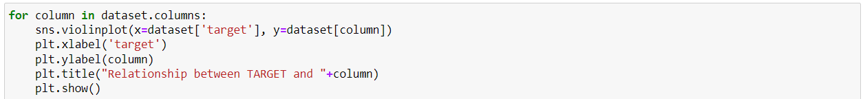
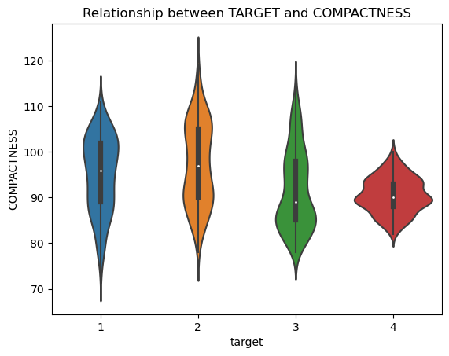
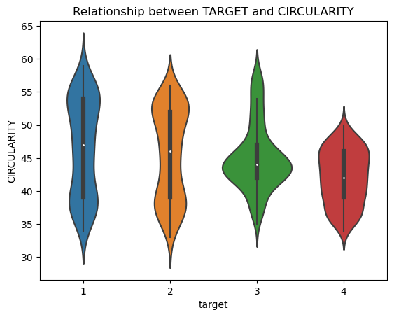
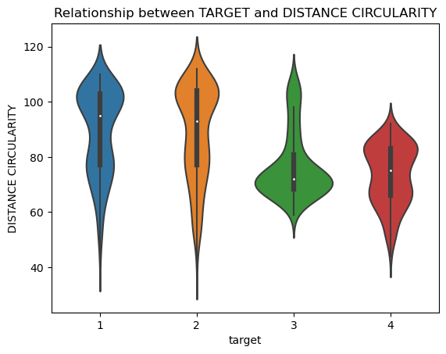
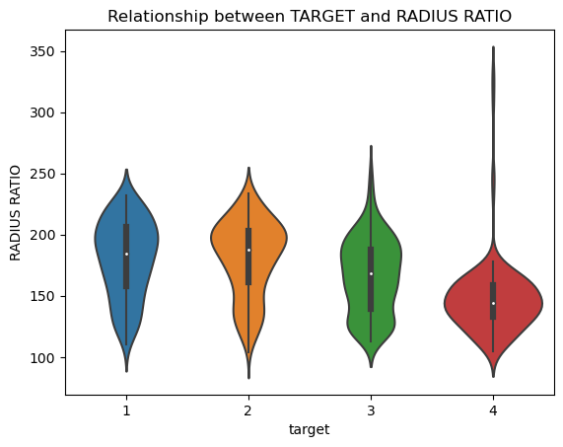
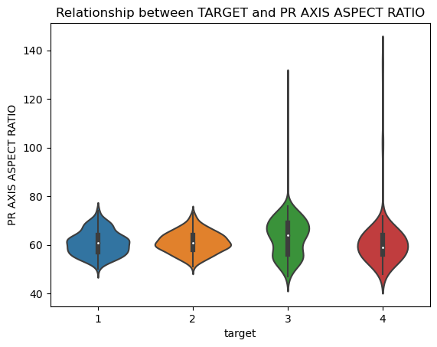
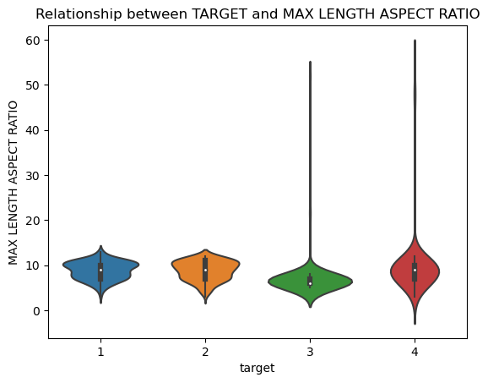
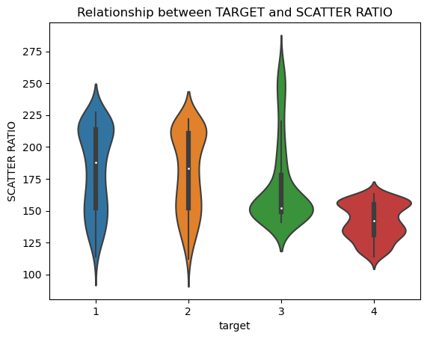
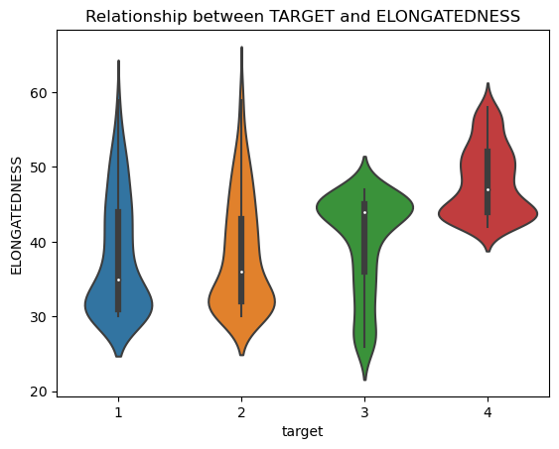
-We can use the violin plot to see the relationship of a numerical feature to a categorical target variable. Violin plot shows the distribution of the feature for each category and also includes boxplot information.

Slide 14
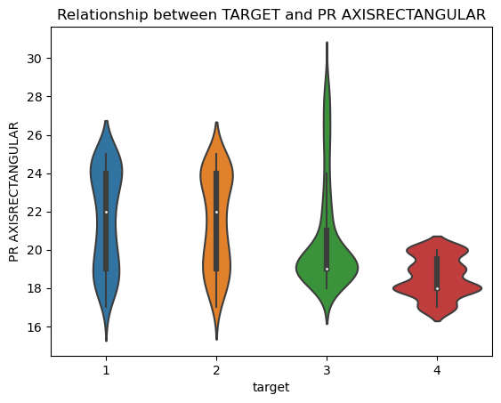
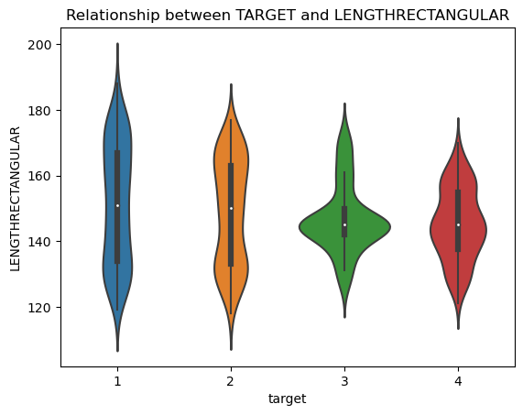
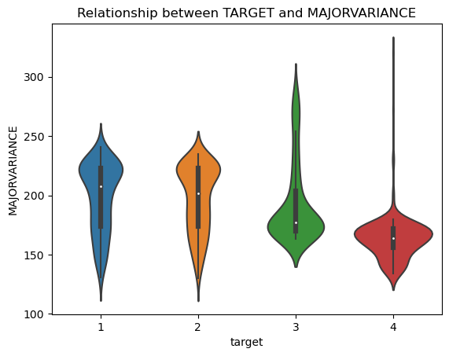
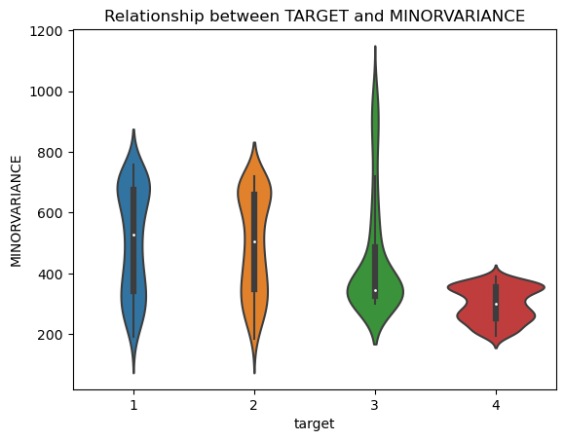
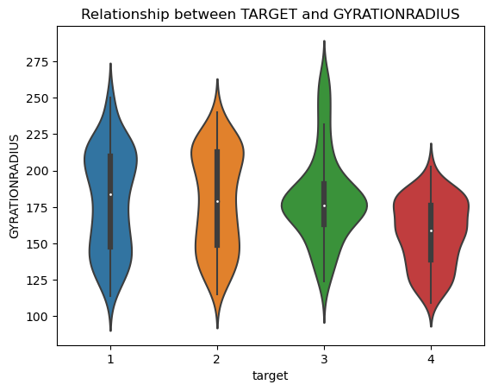
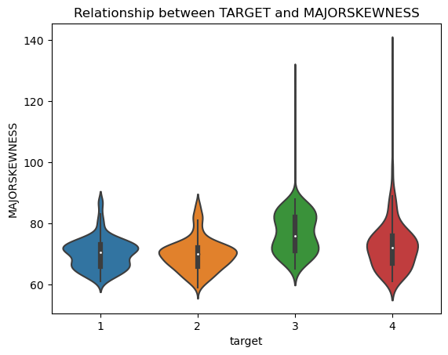
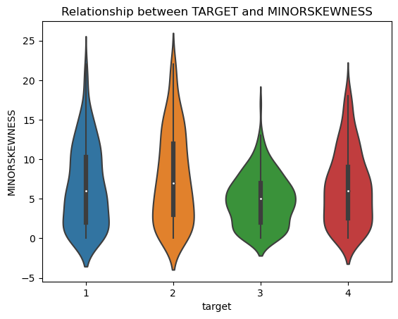
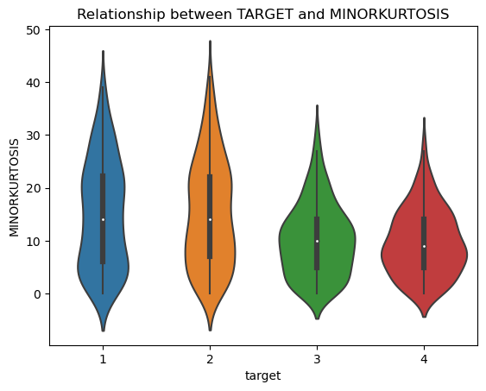
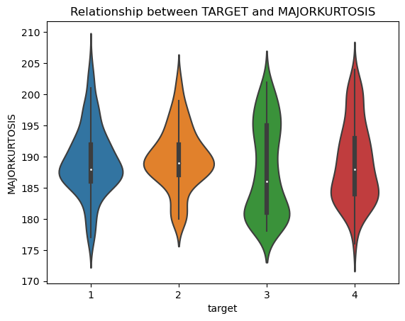



Slide 15










Slide 16












Slide 17










Slide 18











Slide 19

Exploratory data analysis

Slide 20



-Checking for missing values
-We check the missing data of each cell with the "isnull()" function. Then we calculate the number of missing values with the sum() function. This way we can display the number of missing values in each column.
-We can use the "fillna()" and "dropna()" functions to fill or remove rows or columns with missing values.
-We don't have to use these functions because there is no data missing in the data set.

Slide 21


-Visualization of missing values

Slide 22


-Create a box plot for visualize outliers
-In the code, we draw a box plot using the seaborn library. The boxplot is a commonly used method for visualizing outliers. A box is drawn for each column and outliers are represented by dots.

Slide 23


















-When we look at the other data in the dataset, it seems that there are not many outliers. Therefore, there is no need to take any action.

Slide 24


-Detecting duplicate rows
-We can use the duplicated() function to detect duplicate rows in your dataset. This function returns a boolean (True/False) series indicating whether each row is repeated.
We can use the drop_duplicates() function to remove duplicate rows. This function removes duplicate rows from the dataset and returns a cleaned dataset.
After removing duplicate rows, we can check the cleaned dataset.

Slide 25

Correlation
Heatmaps are often used to visualize the correlation matrix. The correlation matrix shows the relationships between the variables with a color scale. High positive correlations are shown in darker color while high negative correlations are shown in lighter color.

Slide 26


Slide 27
Linear Regression and Logistic Regression
K-Nearest Neighbors (KNN)
Decision Tree
PCA and Clustering
Random Forest
Support Vector Machines (SVM)
Gaussian Naive Bayes
Model Selection and Evaluation

Slide 28



Slide 29
Linear Regression Description
Linear Regression is a supervised machine learning algorithm used to predict a continuous target variable based on one or more input features. It assumes a linear relationship between the input features and the target variable. The goal of linear regression is to find the best-fitting line that minimizes the difference between the predicted values and the actual values.
The algorithm works by estimating the coefficients (slope and intercept) of the linear equation that represents the relationship between the input features and the target variable. This estimation is done using a method called Ordinary Least Squares (OLS), which minimizes the sum of the squared differences between the predicted and actual values.
To visualize the linear regression model, you can plot the scatter plot of the data points and overlay the regression line. This helps in understanding the relationship between the input features and the target variable. The scatter plot displays the data points as dots, and the regression line shows the best-fit line that represents the linear relationship.

Slide 30

Linear Regression
-Separating the data set into dependent and independent variables.
-Splitting the dataset into the Training set and Test set.
-Fitting simple linear regression to the training set.
-Obtaining the coefficients of the Linear Regression model.

Slide 31

Linear Regression Cont’d

Slide 32



Linear Regression Cont’d
-In the code, we combine the training and test error values and assign them to the all_errors variable. Next, we plot the distribution of error values as a histogram using the plt.hist() function.

Slide 33



Linear Regression Cont’d
-In this code, we combine the actual values with the predicted values and assign them to the variables y_combined and y_pred_combined. Next, we plot a scatter plot comparing the actual and predicted values using the plt.scatter() function.
-In this code, we calculate errors between actual and predicted values using error metrics such as mean_absolute_error(), mean_squared_error(), and r2_score(). Next, we print these error metrics to the screen.

Slide 34


What can be done to increase the Linear Regression Score?
-Linear Regression with Standard Deviations
-Linear Regression with Polynomial Regression

Slide 35



Cross Validate
Cross-validation is a method used to evaluate the performance of a model.

Slide 36




Cross Validate Cont'd

Slide 37
K-Nearest Neighbors (KNN) Description:
K-Nearest Neighbors (KNN) is a machine learning algorithm used to perform classification or regression based on the closeness measure of data points.
The working principle of the KNN algorithm includes the following steps:
Preparing the Dataset and Labels: The dataset is prepared as a matrix (X) containing the features and a vector (y) containing the corresponding labels (classes or target values).
Choosing a Distance Metric: To make the KNN algorithm work, a distance metric needs to be selected. Euclidean distance is the most commonly used metric, but other metrics can also be preferred.
Creating the Model: The KNN algorithm uses a simple data structure to store the dataset. During the training phase, the algorithm loads the data points into this structure and stores them with their labels.
Making Predictions: When a prediction is requested, the KNN algorithm finds the k nearest neighbors of the selected point. By examining the labels of these neighbors, the prediction is made using the majority class or average.

Slide 38



KNN
-Separating the data set into dependent and independent variables.
-Splitting the dataset into the Training set and Test set.

Slide 39

KNN Cont’d
-Define the model: Init K-NN.
-Fit Model.
-Predict the test set results.

Slide 40



KNN Cont’d
-Calculating performance metrics.
-Print the results.

Slide 41


What can be done to increase the KNN Scores?
-KNN with Standard Deviations
In order for the KNN algorithm to be applied correctly, the features are usually scaled so that they have the same scale. This process normalizes the features in the dataset and helps to represent each feature at the same scale.

Slide 42




-We will reduce our test size to (0.1)

Slide 43
-Comment-
The accuracy score, precision score, recall score, and F1 score we provided are all the same, with a value of 0.7764705882352941.
This indicates that the KNN model achieved an overall accuracy of approximately 77.64%. The precision, recall, and F1 scores are also 77.64%.
In general, having all scores at the same value suggests that the model's performance is consistent across different evaluation metrics.

Slide 44
Decision Tree Description:
Decision Tree is a machine learning algorithm and can be used in classification or regression problems. The Decision Tree creates a set of decision rules using the features in the data set and uses this rule set to classify or predict the value of new data.
The working principle of the decision tree algorithm involves the following steps:
1. Data Preparation: The dataset is prepared with features stored in a matrix (X) and corresponding labels (classes or target values) stored in a vector (y).
2. Decision Tree Construction: The decision tree algorithm creates a tree structure by partitioning the data based on the values of its features. The partitions aim to separate the data in the best possible way in terms of homogeneity or purity. Criteria such as Gini impurity or entropy are used to determine the best splitting criterion.
3. Tree Growth: The decision tree is grown recursively. At each node, the dataset is divided into sub-nodes based on the features. This process continues until a certain stopping criterion is met, such as reaching a maximum depth or a minimum number of data points in a node.
4. Prediction: The decision tree is used to make predictions on new examples. The features of an example are traversed down the branches of the tree to reach a leaf node, which provides the predicted result.

Slide 45
Decision Tree
-Separating the data set into dependent and independent variables.
-Splitting the dataset into the Training set and Test set.
-Create a decision tree classifier and train the classifier on the training data.
-Make predictions on the test data.
-Calculating performance metrics.

Slide 46




Decision Tree Cont’d
What can be done to increase the Decision Tree Scores?
-We will reduce our test size to (0.1).

Slide 47
-Comment-
The Accuracy Score represents the ratio of correctly predicted labels to the total number of examples. A higher accuracy score indicates that the model's predictions are generally more accurate. In this case, the accuracy score is 0.7882, meaning that approximately 78.82% of the predictions are correct.
The Precision Score measures the ratio of true positive predictions to the total number of positive predictions. It evaluates the model's tendency to make false positive predictions. A higher precision score indicates that the model has reduced false positives. In this case, the precision score is 0.8251, meaning that approximately 82.51% of the positive predictions are actually true positives.
The Recall Score measures the ratio of true positive predictions to the total number of actual positive examples. It evaluates the model's ability to correctly identify positive examples and reduce false negatives. A higher recall score indicates that the model has reduced false negatives. In this case, the recall score is 0.7882, meaning that approximately 78.82% of the actual positive examples are correctly predicted as positive.
The F1 Score represents the harmonic mean of precision and recall. It aims to balance precision and recall. If both precision and recall are high, the F1 score will also be high. In this case, the F1 score is 0.8001.

Slide 48
PCA (Principal Component Analysis) Description:
PCA (Principal Component Analysis) is a method used to analyze the relationships between variables in the data set and to make dimension reduction.
The working principle of PCA involves the following steps:
Data Scaling: PCA considers the variability of the data in the analysis. Therefore, all features are scaled to have the same scale in the data scaling step.
Calculation of the Covariance Matrix: The covariance matrix is computed to measure the relationships between variables in the dataset. The covariance matrix represents the relationships and variances between features.
Calculation of Eigenvectors and Eigenvalues: Through eigendecomposition of the covariance matrix, the eigenvalues and corresponding eigenvectors are computed. Eigenvectors serve as the principal components used for the transformation of the data into a new subspace.
Selection of Principal Components: Eigenvalues represent the variability information in the dataset. PCA selects the most important principal components by ordering the eigenvalues from highest to lowest. The selected principal components form the new dimensional representation of the data.
Data Transformation: The dataset is transformed into the new dimensional representation using the selected principal components. This step aims to obtain a lower-dimensional representation of the data.

Slide 49


PCA(Principal Component Analysis)
-Decision Tree Example without PCA.

Slide 50


PCA(Principal Component Analysis) Cont’d
-Decision Tree Example with PCA.
-Comment-
PCA is not generally used with Decision Tree.
However, in some cases PCA can be used to visualize or reduce the complexity caused by the high dimensionality in the dataset.

Slide 51


PCA(Principal Component Analysis) Cont’d
-KNN Example without PCA.

Slide 52


PCA(Principal Component Analysis) Cont’d
-KNN Example with PCA (n_components = 2).

Slide 53
-Comment-
In the provided code, K-Nearest Neighbors (KNN) algorithm is used for classification, and the effect of applying Principal Component Analysis (PCA) on the algorithm's performance is demonstrated. Here are the explanations for the results:
KNN without PCA:
-Accuracy Score: 0.7882
-Precision Score: 0.7882
-Recall Score: 0.7882
-F1 Score: 0.7882
In this case, KNN is applied directly to the standardized data without using PCA. The accuracy, precision, recall, and F1 score are all approximately 0.7882.
KNN with PCA:
-Accuracy Score: 0.4471
-Precision Score: 0.4471
-Recall Score: 0.4471
-F1 Score: 0.4471
In this case, PCA is applied to the standardized data before using KNN. The data is transformed into a lower-dimensional space using PCA, specifically with 2 components. Then, KNN is applied to the transformed data. However, the accuracy, precision, recall, and F1 score decrease significantly compared to the case without using PCA. This indicates that PCA may not be suitable for this dataset and choice of components.
Result:
1. The higher the accuracy, precision, recall, and F1 score, the better the model's performance.
2. In the case without PCA, the KNN model achieves a higher performance, as indicated by the higher scores.
3. However, in the case with PCA, the performance of the KNN model decreases, which suggests that applying PCA in this manner may not be beneficial for this dataset.

Slide 54


PCA(Principal Component Analysis) Cont’d
-KNN Example with PCA(n_components = 8).
Comment: In the first case, where PCA is not used, the accuracy, precision, recall, and F1 scores are all 0.7882. This means that the KNN model achieved an overall accuracy of 78.82% in predicting the correct labels. The precision score indicates that 78.82% of the predicted positive instances were positive, while the recall score indicates that 78.82% of the true positive instances were correctly identified. The F1 score, which is the harmonic mean of precision and recall, is also 0.7882.
In the second case, where PCA is used, the scores remain the same as in the previous case. This suggests that applying PCA did not significantly impact the performance of the KNN algorithm in this specific scenario.

Slide 55




PCA(Principal Component Analysis) Cont’d

Slide 56
Random Forest Description:
Random Forest is an ensemble (community) algorithm formed by many decision trees. Each decision tree is trained using random sampling and random feature selection, and as a result, the algorithm combines the predictions of these trees to make a more accurate and stable prediction.
Random Forest algorithm can be explained as follows:
Data Preparation: The dataset is prepared as a matrix (X) containing the features and a vector (y) containing the corresponding labels (classes or target values).
Creation of Decision Trees: Random Forest creates a specified number of decision trees. Each tree is trained using a random subset of the data and a random subset of the features.
Training the Trees: Each decision tree is trained using the selected subset of data and features. The tree creates a tree structure by recursively splitting the data based on the values of the features.
Prediction: New samples can be predicted using the created decision trees. Predictions from each tree are combined to make the final prediction, such as determining the class label.

Slide 57

Random Forest
-Separating the data set into dependent and independent variables.
-Split the dataset into training and testing sets.
-Building and training the Random Forest classifier model.
-Making predictions on test data.
-Calculating performance metrics.

Slide 58



Random Forest Cont’d
What can be done to increase the Random Forest Scores?
-Random Forest with PCA

Slide 59
-Comment-
These scores are metrics used to evaluate the performance of a model. The Accuracy Score represents the model's ability to make correct predictions. The Precision Score indicates the proportion of correctly predicted positive instances out of all instances predicted as positive. The Recall Score measures the proportion of correctly predicted positive instances out of all actual positive instances. The F1 Score aims to strike a balance between Precision and Recall.
In this case, the scores indicate that the model has performed well. Since all the scores are the same, it suggests that the model has achieved high accuracy, precision, recall, and F1 score. However, it is important to determine whether these scores are acceptable based on the specific problem and dataset. To improve or increase these scores, various strategies can be employed depending on the data, such as gathering more data, applying data preprocessing techniques, tuning model parameters, or considering alternative models.
In the second case, where PCA is used, the scores remain the same as in the previous case. This suggests that applying PCA did not significantly impact the performance of the Random Forest algorithm in this specific scenario.

Slide 60
Support Vector Machines Description:
Support Vector Machines is a machine learning algorithm used for classification and regression problems. SVM tries to find a hyperplane that separates the data well.
The basic steps involved in the SVM algorithm are:
1. Data Preparation: SVM requires a labeled dataset with features and corresponding class labels. The features should be numeric or converted into numerical representations.
2. Feature Scaling: It is essential to scale the features to a similar range to ensure fair treatment during the optimization process. Common scaling techniques include standardization (subtracting mean and dividing by standard deviation) or normalization (scaling values between 0 and 1).
3. Model Training: SVM determines the optimal hyperplane by finding support vectors, which are the data points closest to the decision boundary. The algorithm aims to maximize the margin (distance) between the support vectors of different classes.
4. Kernel Trick (optional): SVM can use a kernel function to transform the original feature space into a higher-dimensional space, allowing for better separation of classes. Common kernel functions include linear, polynomial, and radial basis function (RBF).
5. Model Evaluation: Once the SVM model is trained, it can be used to predict the class labels of unseen data points. The performance of the model can be assessed using various evaluation metrics such as accuracy, precision, recall, and F1 score.

Slide 61

Support Vector Machines (SVM)
-Separating the data set into dependent and independent variables.
-Split the dataset into training and testing sets.
-Build and train the SVM model.
-Making predictions on test data.
-Calculating performance metrics.

Slide 62


Support Vector Machines (SVM) Cont’d
What can be done to increase the SVM Scores?
-Support Vector Machines (SVM) with Standard Deviations

Slide 63

Support Vector Machines (SVM) Cont’d
-Support Vector Machines (SVM) with PCA

Slide 64
-Comment-
Based on these scores, it can be observed that the SVM algorithm performs poorly. In all three cases, the accuracy, precision, recall, and F1 scores are the same and have a low value. This indicates that the model has low performance in the classification task and its predictions are generally inaccurate.
Preprocessing the data using standard deviations did not make any difference in improving the results. In this case, standardizing the dataset did not effectively enhance the performance of the SVM algorithm.
However, when PCA is used, there is an improvement in the model's performance. The accuracy, precision, recall, and F1 scores are slightly higher. This indicates that PCA, by transforming the dataset into a lower-dimensional space, helps the SVM model perform better.
In conclusion, to enhance the performance of the SVM model, dimensionality reduction techniques like PCA can be employed. However, it is important to select the optimal number of components and make adjustments based on the characteristics of the dataset for effective implementation of PCA. Additionally, considering steps such as hyperparameter tuning, data preprocessing methods, and experimenting with different kernel functions can also improve the performance of SVM.

Slide 65
Clustering Description:
Clustering is a machine learning method used to group data according to certain characteristics. Clustering algorithms try to group data into clusters based on the similarity measure in the data set.
Clustering algorithms are based on different approaches and mathematical principles. Some popular clustering algorithms include:
1. K-Means: It is an iterative algorithm that assigns data points to K number of clusters/centroids. In each iteration, data points are assigned to the clusters that are closest to their centroids, and the centroids are recalculated.
2. Hierarchical Clustering: It groups data points into a hierarchical tree-like structure. This algorithm can work in two approaches: agglomerative (bottom-up) or divisive (top-down). In the agglomerative approach, each data point starts as a separate cluster, and similar clusters are merged together to form a hierarchical tree. In the divisive approach, all data points start in a single cluster, and the tree structure is built by dividing the clusters.
3. DBSCAN (Density-Based Spatial Clustering of Applications with Noise): It is a density-based clustering algorithm. This algorithm identifies dense regions and sparse regions of data points to perform clustering. Data points are assigned to clusters based on a density threshold and neighborhood relationship.

Slide 66


Clustering
-Separating the data set into dependent and independent variables.
-Elbow method: In this method, the total inertia value decreases as the number of clusters increases. The Elbow method tries to find the "elbow" where the rate of decline of the inertia value slows down to determine the number of clusters. We can determine the optimal number of clusters by calculating and graphing the inertia values for different cluster numbers using the Elbow method.

Slide 67

Clustering Cont’d
-Analyze the resulting cluster tags.

Slide 68
Logistic Regression Description:
Logistic Regression is a popular supervised learning algorithm used for binary classification problems. It models the relationship between a set of independent variables (features) and a binary dependent variable (target) by estimating the probability of the target variable belonging to a particular class.
The algorithm uses a logistic function (also known as the sigmoid function) to model the relationship between the input features and the probability of the target variable being in the positive class. The logistic function maps any real-valued number to a value between 0 and 1, representing the probability. The logistic regression model learns the coefficients (weights) of the input features to maximize the likelihood of the observed data.
During training, the algorithm optimizes the coefficients using various optimization techniques such as gradient descent or Newton's method. The objective is to minimize a cost function, which measures the discrepancy between the predicted probabilities and the true class labels.
For visualization in logistic regression, one common approach is to plot the decision boundary. Since logistic regression is a linear classifier, the decision boundary is a straight line or a hyperplane in higher dimensions. By plotting the decision boundary along with the training data points, you can visually observe how the algorithm separates the classes.

Slide 69

Logistic Regression
-Separating the data set into dependent and independent variables.
-Splitting the dataset into the Training set and Test set.
-Build and train the Logistic Regression model.
-Making predictions on test data
-Calculating performance metrics.

Slide 70



Logistic Regression Cont’d
What can be done to increase the Logistic Regression Scores?
- Logistic Regression with Standard Deviations

Slide 71

Logistic Regression Cont’d
- Logistic Regression with PCA

Slide 72
-Comment-
Based on the above scores, we can say that the Logistic Regression model has generally performed well. The high accuracy score and precision score indicate a high rate of correct predictions and a low number of false positive predictions. However, the recall score is slightly lower, indicating a slightly higher number of false negative predictions.
The approach of using Standard Deviations in Logistic Regression, where the data is scaled using standard deviations, resulted in better accuracy score and precision score.
The approach of using PCA (Principal Component Analysis) in Logistic Regression, where the data is reduced in dimensionality, resulted in lower accuracy score and precision score, indicating lower model performance.

Slide 73
Gaussian Naive Bayes Description:
Gaussian Naive Bayes is a classification algorithm used in statistics and machine learning to solve classification problems. Naive Bayes classifiers make use of Bayes' theorem to perform classification. This algorithm uses the probabilities of features to classify an instance.
Gaussian Naive Bayes assumes that the features have a Gaussian (normal) distribution. In other words, it assumes that the distribution of each feature is normal for each class. Under this assumption, the class means and variances for each feature are estimated.
The working principle of Gaussian Naive Bayes consists of the following steps:
1. Data preparation: First, a dataset is collected to perform classification, which includes the relationships between features and target classes.
2. Estimation of feature distributions: The mean and variance for each feature are estimated for each class. This assumes that the features of each class follow a normal distribution.
3. Application of Bayes' theorem: Bayes' theorem is used to predict the class. Bayes' theorem calculates the role of features in determining the class.
4. Classification decision: The class with the highest probability is selected based on the calculated probabilities using Bayes' theorem. In other words, given an instance, the class with the highest probability is predicted.
The Gaussian Naive Bayes algorithm is simple and fast. It also works under the assumption that the relationships between features are independent, so it may not perform well when the dataset is very large or when the relationships between features are complex. However, this assumption can sometimes be appropriate in real-world datasets, and Gaussian Naive Bayes can still be an effective classification method.

Slide 74


Gaussian Naive Bayes

Slide 75


Gaussian Naive Bayes Cont’d
What can be done to increase the Gaussian Naive Bayes Scores?
- Gaussian Naive Bayes with Standard Deviations
Comment: The Gaussian Naive Bayes model shows the lowest performance. The accuracy, precision, recall, and F1-score values are approximately equal and around 44%. The model classifies the dataset relatively weakly compared to other models.
Preprocessing the data using standard deviations did not make any difference in improving the results. In this case, standardizing the dataset did not effectively enhance the performance of the NB algorithm.

Slide 76



6 Classification Algorithms Example

Slide 77
-Comment-
KNN: The accuracy, precision, recall, and F1-score values of this model are approximately equal and around 69%. The model classifies the dataset relatively well, but it shows slightly lower performance compared to other models.
DT: The performance of the Decision Tree model is like KNN. The accuracy, precision, recall, and F1-score values are approximately equal and around 71%. The model classifies the dataset relatively well, but it shows slightly lower performance compared to other models.
RF: The Random Forest model shows better performance. The accuracy, precision, recall, and F1-score values are approximately equal and around 75%. The model classifies the dataset better than KNN and DT models.
SVM: The Support Vector Machine model demonstrates quite good performance. The accuracy, precision, recall, and F1-score values are approximately equal and around 79%. The model classifies the dataset well and shows higher performance compared to previous models.
LR: The Logistic Regression model performs the best. The accuracy, precision, recall, and F1-score values are approximately equal and around 83%. The model classifies the dataset most effectively and exhibits higher performance compared to other models.
NB: The Gaussian Naive Bayes model shows the lowest performance. The accuracy, precision, recall, and F1-score values are approximately equal and around 44%. The model classifies the dataset relatively weakly compared to other models.
In general, models with higher accuracy, precision, recall, and F1-score values indicate better performance. These scores can help you compare the classification capabilities and accuracies of each model. However, the preferences in model selection can vary depending on the characteristics of the dataset, the objective, and the application domain.

Slide 78
Source
https://www.kaggle.com/datasets/patriciabrezeanu/statlog-vehicle-silhouettes
https://www.simplilearn.com/10-algorithms-machine-learning-engineers-need-to-know-article
https://www.javatpoint.com/machine-learning-algorithms
https://builtin.com/data-science/tour-top-10-algorithms-machine-learning-newbies
https://www.analyticsvidhya.com/blog/2017/09/common-machine-learning-algorithms/
https://www.dataquest.io/blog/top-10-machine-learning-algorithms-for-beginners/

Slide 79
Thank you
Ünal Ramazan Doğangün
https://www.doftdare.com/

